Slide 1


The Algorithm Of
Speed Dating
Identifying the Key Factors of a Successful Match
Project Team: Holly Burd, Tyler Chambers, Yurii Hehediush, Jana Abdul Razzak, Eric Rosen, Aaron Lint

Slide 2

Introduction:
Speed Dating: The Art of First Impressions
What is Speed Dating? This is a fast-dating technique whereby one gets to meet several potential matches within minutes.
Quick Connections: Just a few minutes to let you know if there's a spark—personality, looks, or chemistry.
First Impressions Matter: Fast decisions according to the first vibes and attraction.
Stripped-Down: It boils down to the bare essentials - what really makes or breaks a connection.

Slide 3

Literature Review of Journal Articles:
How Previous Research Was Conducted
Speed-Dating as an Invaluable Tool for the Study of Romantic Attraction (Finkel et al., 2007) – Highlights the mechanisms of speed-dating, concentrating on first romantic attraction in real-time settings.
From Dating to Mating: Predictors of Speed-Dating Success (Asendorpf et al., 2011) - Examines how physical attractiveness and sociosexuality predict both short-term and long-term dating outcomes.
Romantic Attraction: Similarity, Reciprocity, and Beauty (Luo et al., , 2009) – Analyzes the role of physical attractiveness in romantic attraction compared to similarity and reciprocity.
Predicting Speed-Date Outcomes with Conversational and Network Features (Pierson et al., 2015) - Evaluates the influence of conversational and social network features on speed-dating success, controlling for the effects of physical appearance.

Slide 4
Research Questions & Methods
Which underlying factors are most influential in determining the outcomes of speed dating events? Analyzed with Principal Component Analysis (PCA)
What’s the relationship between self-rating attractiveness and successful speed-dating outcomes? Analyzed with Canonical Correlation Analysis (CCA)
What factors are most important when it comes to speed dating? Analyzed with Factor Analysis (FA)

Slide 5
Research Questions & Methods
How do participant demographics, preferences, and perceived attributes relate to the likelihood of forming a match during speed dating events? Analyzed with Correspondence Analysis (CA)
What variables strongly influence overall satisfaction with the people met during a speed dating event? Analyzed with Lasso Regression
What factors influence an individual's self-perception of attractiveness in the dating context? Analyzed with Ridge Regression

Slide 6
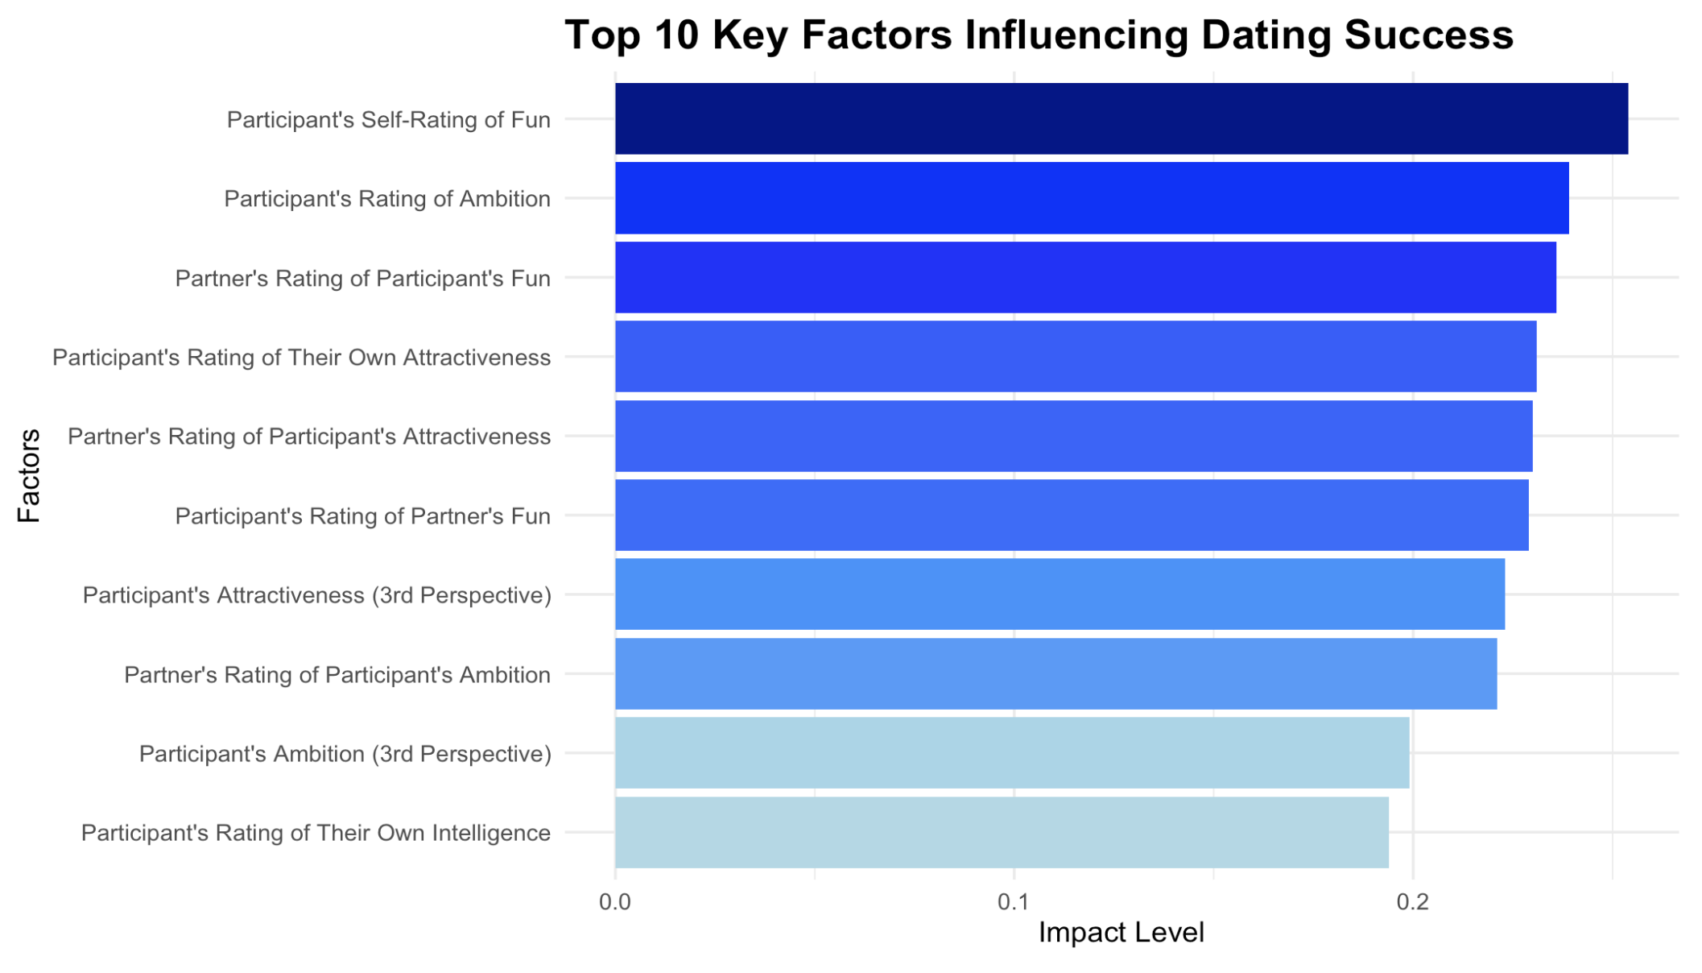
PCA: Key Factors Influencing Speed Dating Outcomes
Key traits driving success in matches.
Self-perception and external ratings both matter.
Fun, ambition, attractiveness are pivotal.
Personality and appearance intertwined.

Slide 7
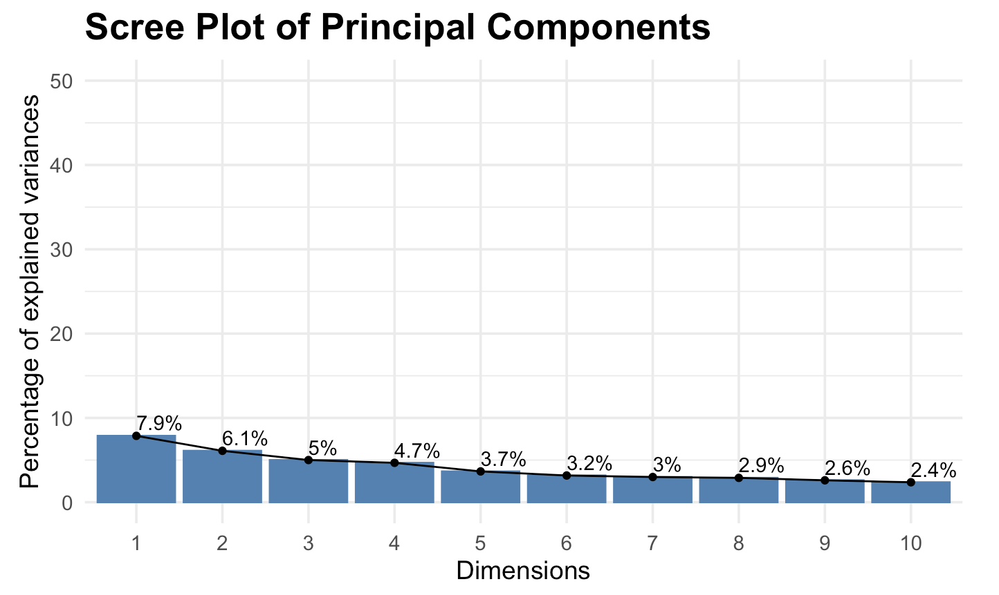
Cumulative Variance Explained by Principal Components
How Much Each Factor Explains the Differences in Outcomes
Significant drop after the 4th and 5th components.
Top components are personality-driven.
Physical appearance comes after personality.
Fun and ambition outweigh attractiveness.

Slide 8
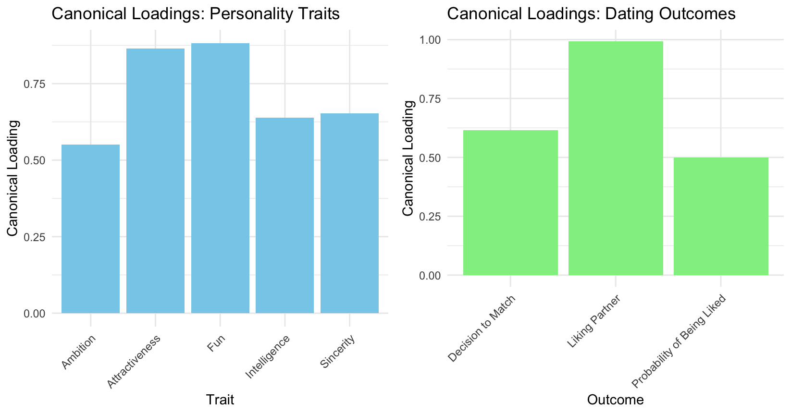
Canonical Correlation Analysis: Self-Perception’s Relationship to a Successful Date
The loadings of the variates show that each self-rating question has a strong positive relationship with the Confidence Levels Variate.
The Outcomes Variate is heavily loaded by the answer to whether the self-rater ends up liking their partner. 99% of the variance of the outcome of liking the date can be explained by a participant’s own perception of themselves.

Slide 9
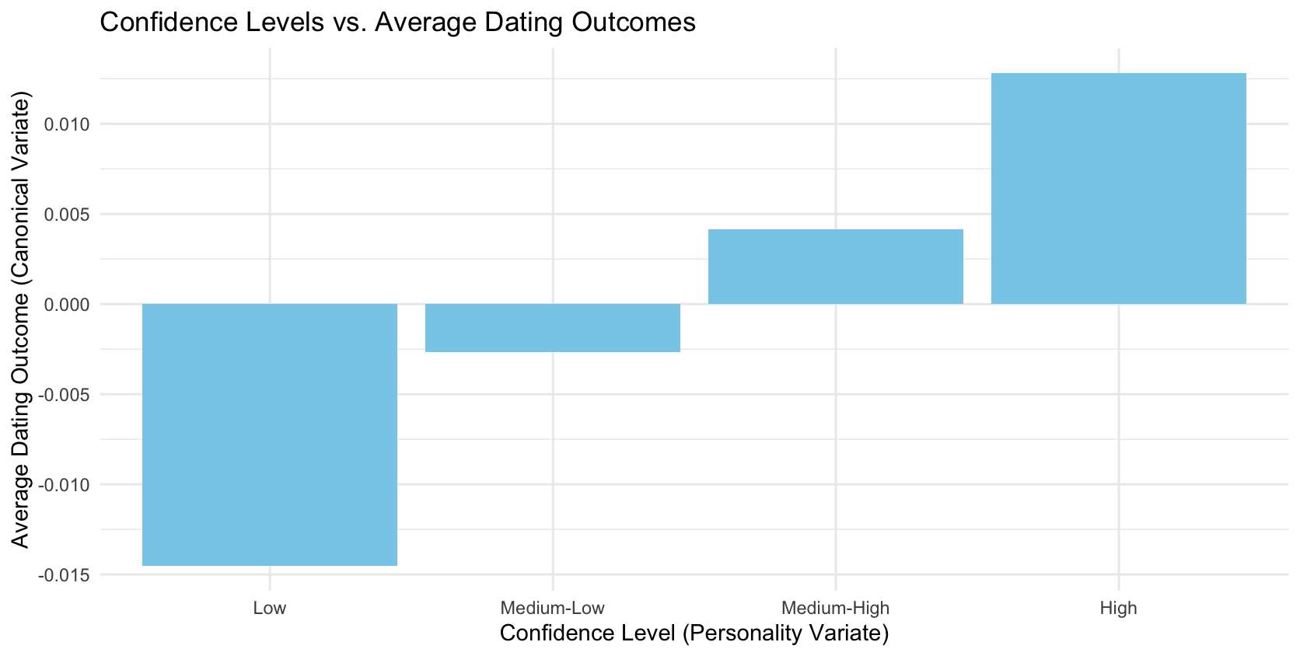
Confidence Levels vs Average Dating Outcomes
The Confidence Level Variate resulting from the CCA, is made up of answers to questions about a participants’ personality. The questions ask the dater to rate their attractiveness, intelligence, fun, and ambition.
The Outcomes variate, our independent variables, include answers to questions on the participant’s, how much they liked their partner, and the probability of being liked.

Slide 10
Factor Analysis of Speed Dating Aspects
The variables were split into 4 different factors, and each showcases a unique aspect of the speed dating experience
These 4 factors explain 45.1% of the shared variance of all the variables
Participant's Self-Perception: How the speed dating participants see themselves
Participant's Ideal Partner: What the speed dating participant looks for in a partner
Date's Perception of Participant: What the participant's date thinks of the participant
Participant's Perception of Date: What the participant thinks of their date

Slide 11
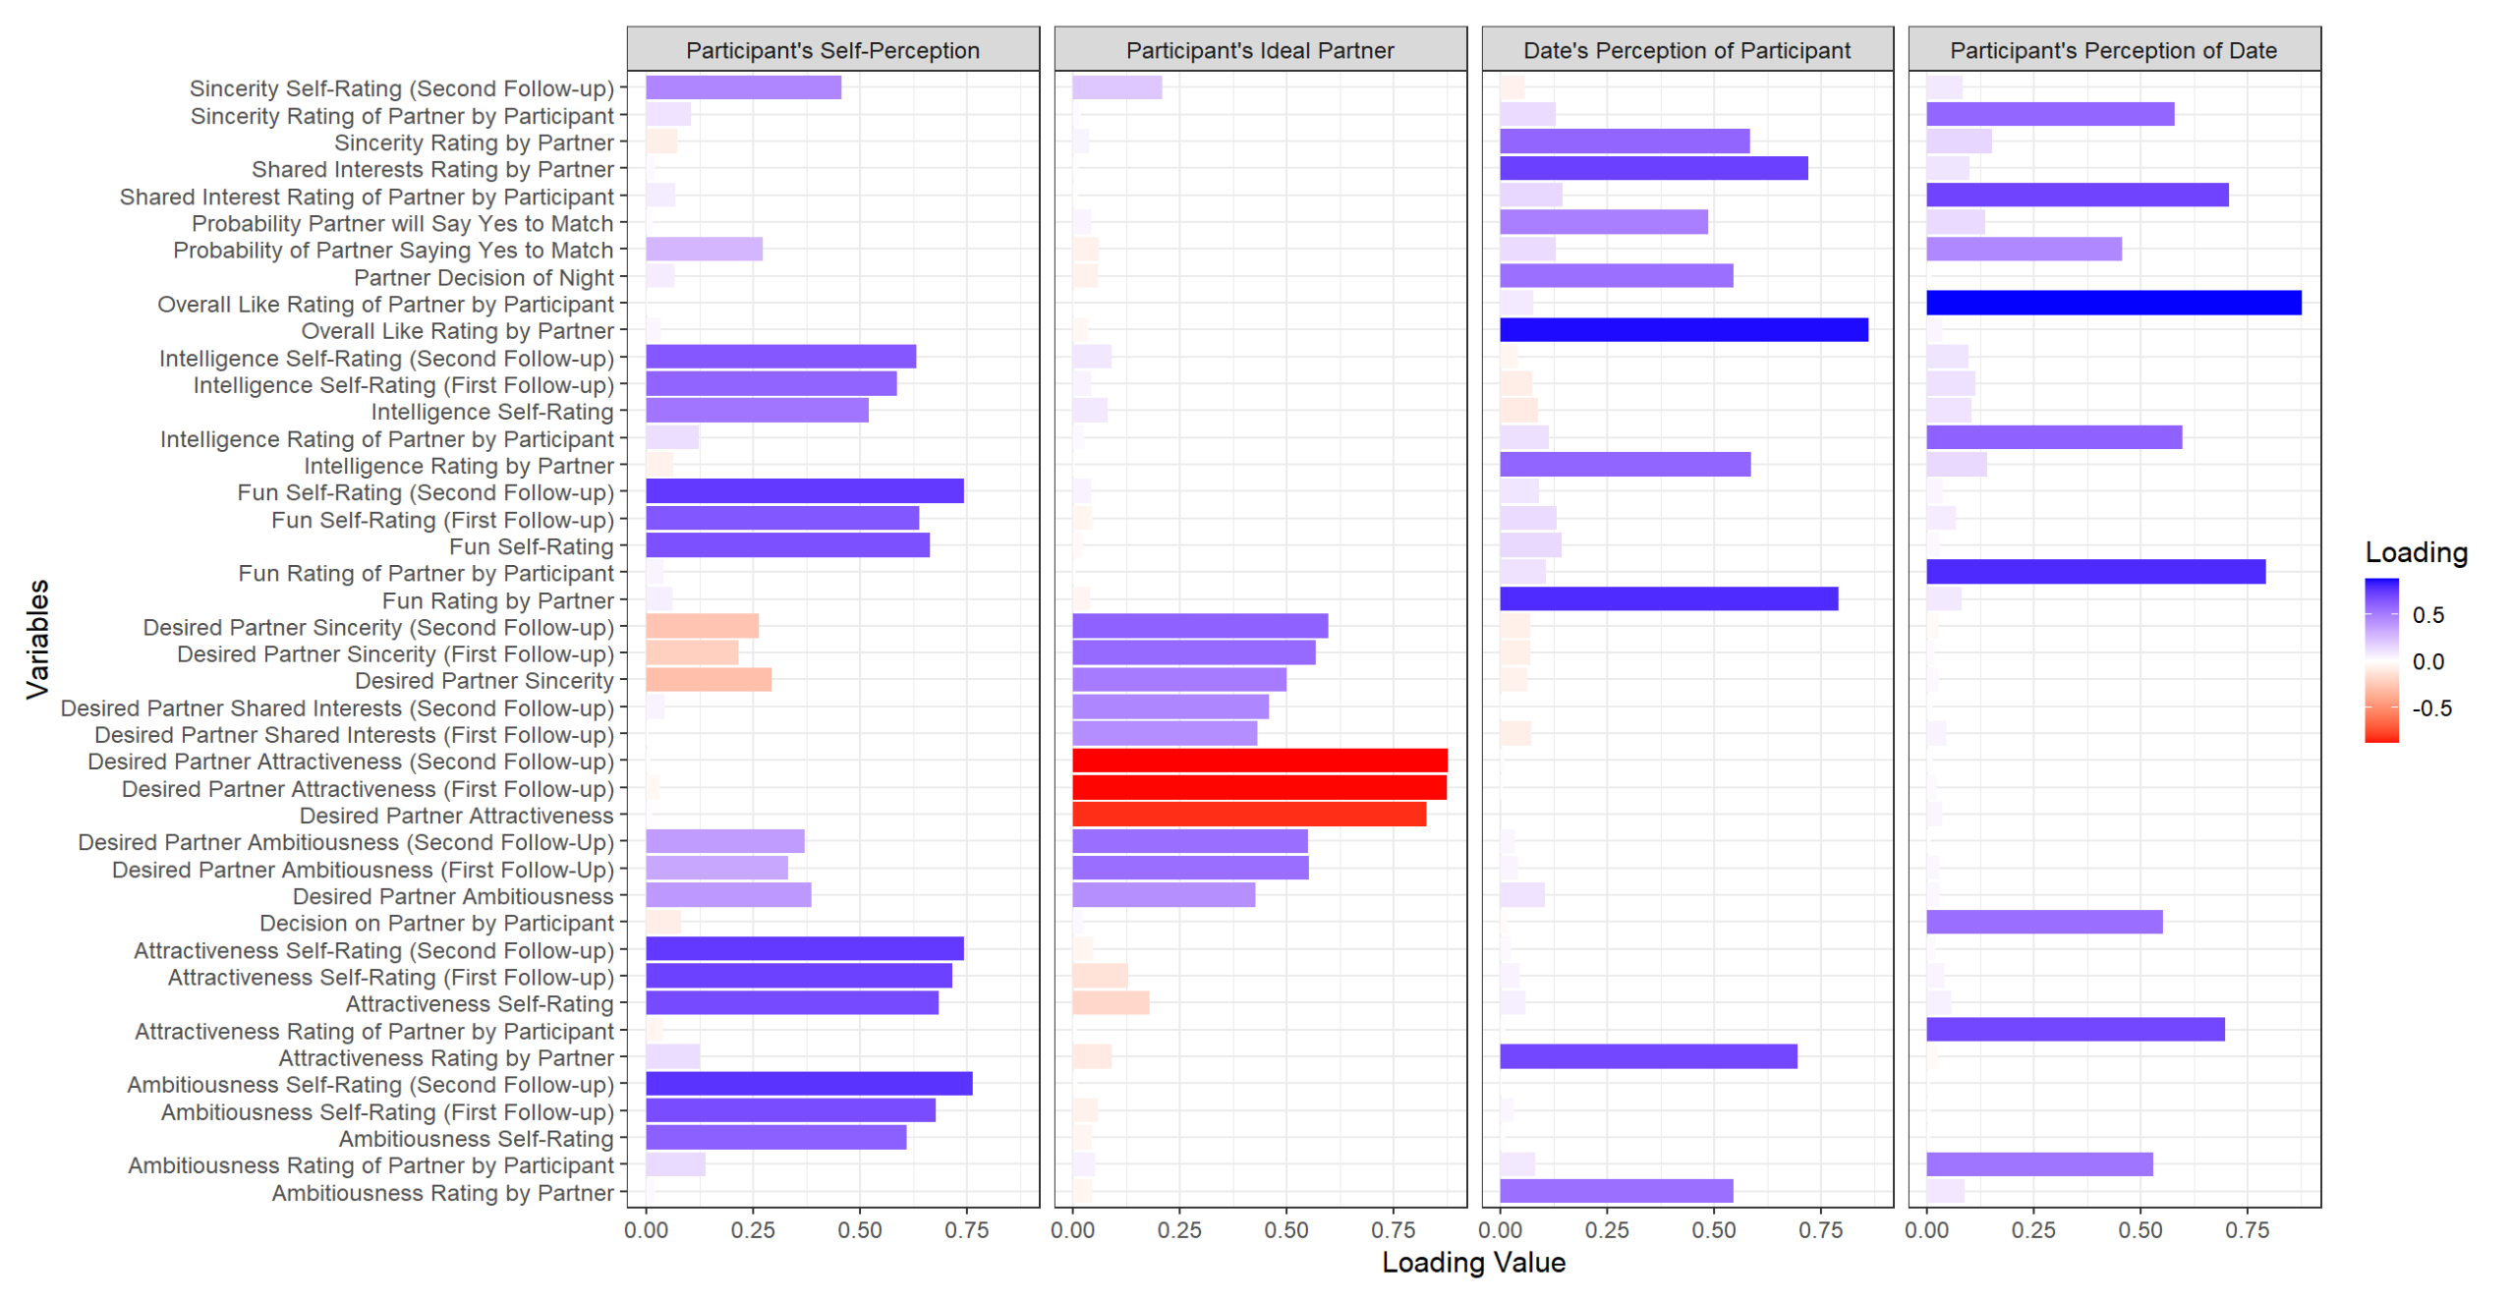
Breakdown of Variables in Each Factor
The attractiveness variables are the only variables that have negative loading values

Slide 12
Correspondence Analysis
Correspondence Analysis:
Shows relationships between categorical variables and match likelihood.
Visual Representation:
Biplots depict how closely related categories are; proximity on the plot indicates a stronger relationship.
Influential Factors:
Attractiveness, perceived attributes, and preferred age are more influential in match success.
Key Attributes:
"Attractiveness" and "Fun" are closer to successful matches, indicating a higher likelihood of forming a match.
Less Influential Factors:
Demographic factors like race and field of work have less influence on match outcomes.
Statistical Significance:
Chi-squared test p-value confirms that the observed relationships in the data are statistically significant.
Shared interests, such as similar hobbies or lifestyle preferences, are strongly linked to successful matches.
Demographic factors, including age and education level, significantly influence match success.

Slide 13
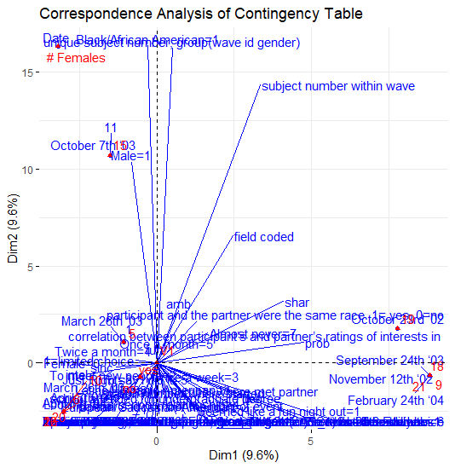
Results using Correspondence Analysis
Correspondence Analysis Overview:
Useful for visualizing relationships between rows and columns of contingency tables with categorical data.
Applicable to categories like demographics, preferences, and match outcomes.
Key Dimensions:
The analysis reduces data into a few key dimensions that capture the most variance.
Dimensions 1 and 2 represent the most significant associations between variables, helping to identify factors closely linked to match formation.
Chi-Square Test:
The significant Chi-square test result (p-value = 0) indicates that the relationships observed are not due to random chance.
Confirms meaningful associations between demographics, preferences, perceived attributes, and match likelihood.
Proximity in Biplots:
Biplots from the CA show relationships between variables.
Categories closer to the "match" outcome in the plot are statistically more likely to be associated with successful matches. For example, attributes like "attractive" and "fun" near "match" imply a higher likelihood of forming a match for those perceived as such.
RESULTS:
Demographics Influence: Younger participants and those perceived as more attractive are more likely to form successful matches in speed dating.
Preferences and Attributes: Attributes like attractiveness, intelligence, and fun are closely linked with match success, indicating that participants who excel in these areas are more desirable and likely to form matches.

Slide 14

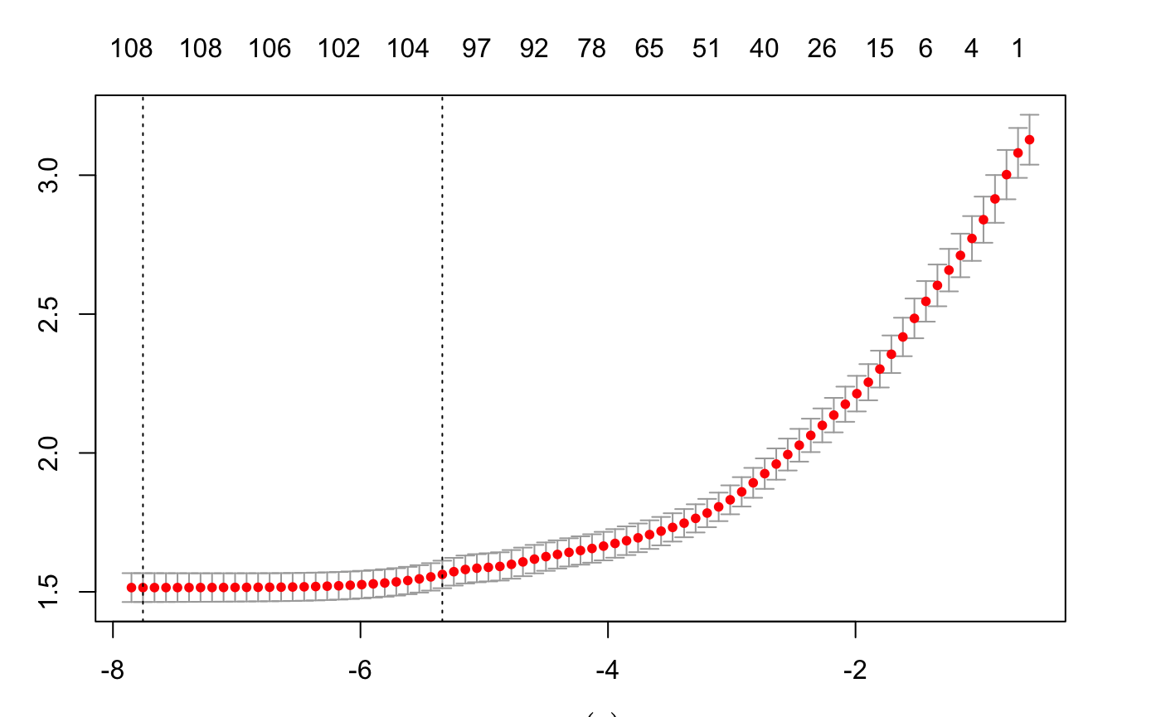
Lasso + Forward and Linear Regression:
Ended with 40 X variables
Final Model can explain 44 percent variance of satisfaction with people met

Slide 15
What affects satisfaction with people you meet during speed dating:
Positive Influences
Matches that went on dates
The number of people met
Expected happiness before the event
Similar goals
concerts
Negative Influences
Highly ambitious less satisfaction
TV
Music Yoga and Theater
Clubbing

Slide 16
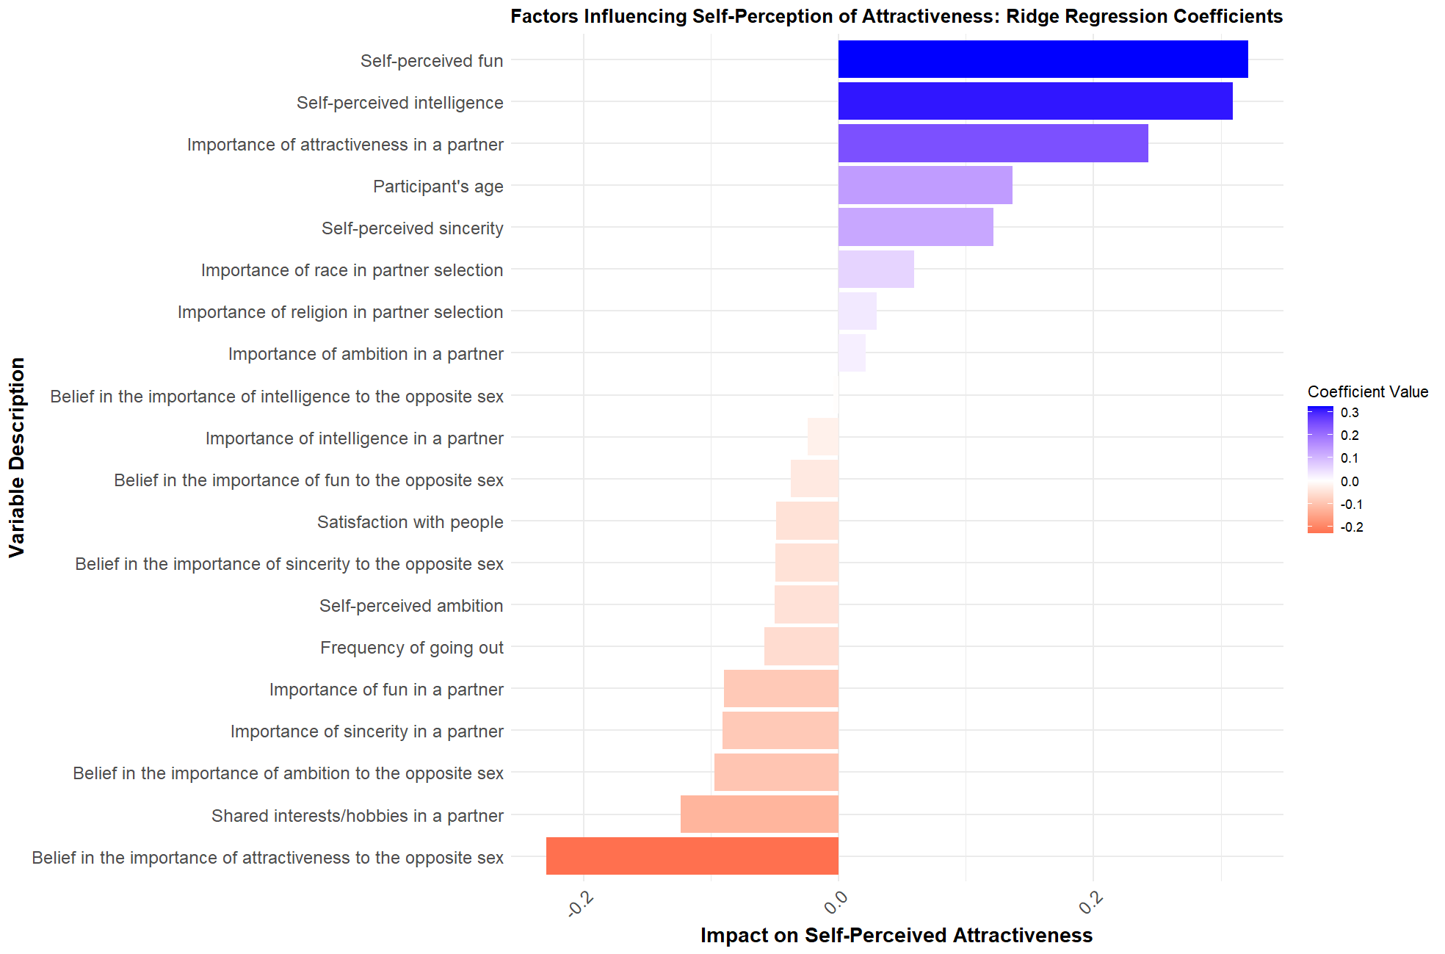
Ridge Regression Analysis on Self-Perceived Attractiveness
Coefficients explain +/- relationship with dependent variable

Slide 17
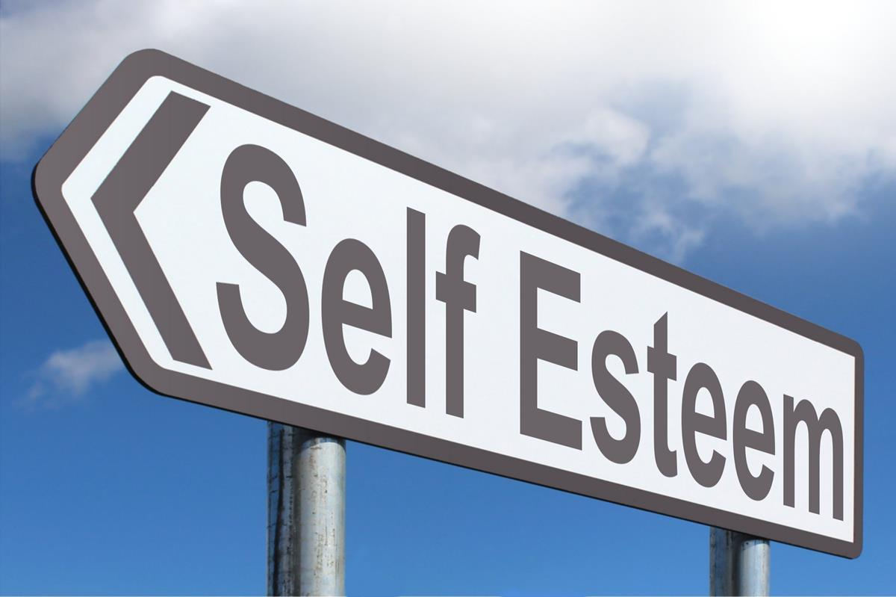
Discussion & Implications of Ridge Regression Findings
Interpretations & Key Insights
Self-Perceived fun, self-perceived intelligence have high impact
Suggestions of high self-esteem
Internal over external
Attractive partner, attractive me
Age a factor (Unexpected finding)
Positive relationship- increased confidence?
If partner values attractiveness, I'm not attractive.
Psychological implications- self-critical
Pressure to meet perceived standards
ThePhoto by PhotoAuthor is licensed under CCYYSA.

Slide 18
Limitations/Future Work
75% of our data had missing values that we could not remove, and 85 variables had to be removed before analysis could begin
Data was collected from 2002-2004
Advent of social media, dating apps, COVID-19, etc. has changed the dating landscape

Slide 19
Future Work
Repeating this study in the current day would give more insights on the current speed dating experience
Data was collected at Columbia University
Repeating this study outside a college environment would allow the study to be more generalizable to the entire population

Slide 20

Conclusion
Confidence is key
Shared Interests Matter
Demographic influence

Slide 21
References
Asendorpf, J. B., Penke, L., & Back, M. D. (2011). From dating to mating and relating: Predictors of initial and long–term outcomes of speed–dating in a community sample. European Journal of Personality, 25(1), 16–30. https://doi.org/10.1002/per.768
FINKEL, E. J., EASTWICK, P. W., & MATTHEWS, J. (2007). Speed‐dating as an invaluable tool for studying Romantic attraction: A methodological primer. Personal Relationships, 14(1), 149–166. https://doi.org/10.1111/j.1475-6811.2006.00146.x
Luo, S., & Zhang, G. (2009). What leads to romantic attraction: Similarity, reciprocity, security, or beauty? evidence from a speed‐dating study. Journal of Personality, 77(4), 933–964. https://doi.org/10.1111/j.1467-6494.2009.00570.x
Pierson, E., & Suciu, A. (2015). Predicting Speed-Date Outcomes with Conversational and Network Features. Retrieved August 16, 2016,.

Slide 22
Thank You

